Slide 1

4-dars
Iterator va generatorlar

Slide 2
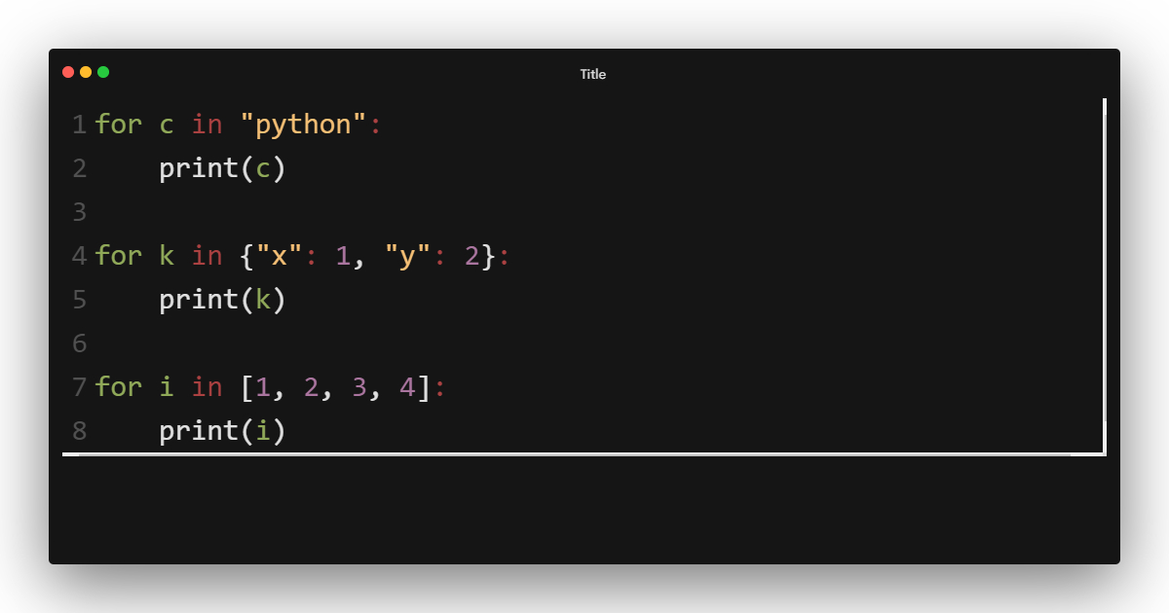
Iteratorlar
Iterable

Slide 3
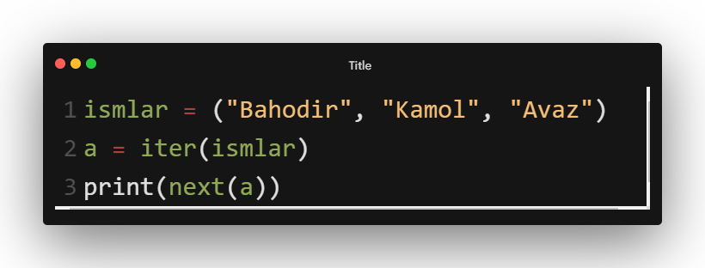
Iterator yaratish
next() == loopdagi element
iter() == for loop

Slide 4
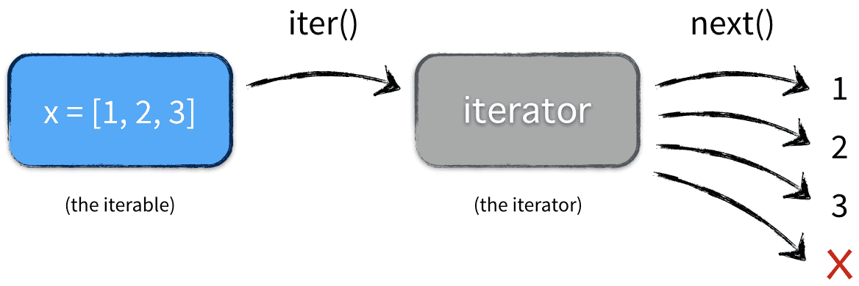
Iterator yaratish

Slide 5
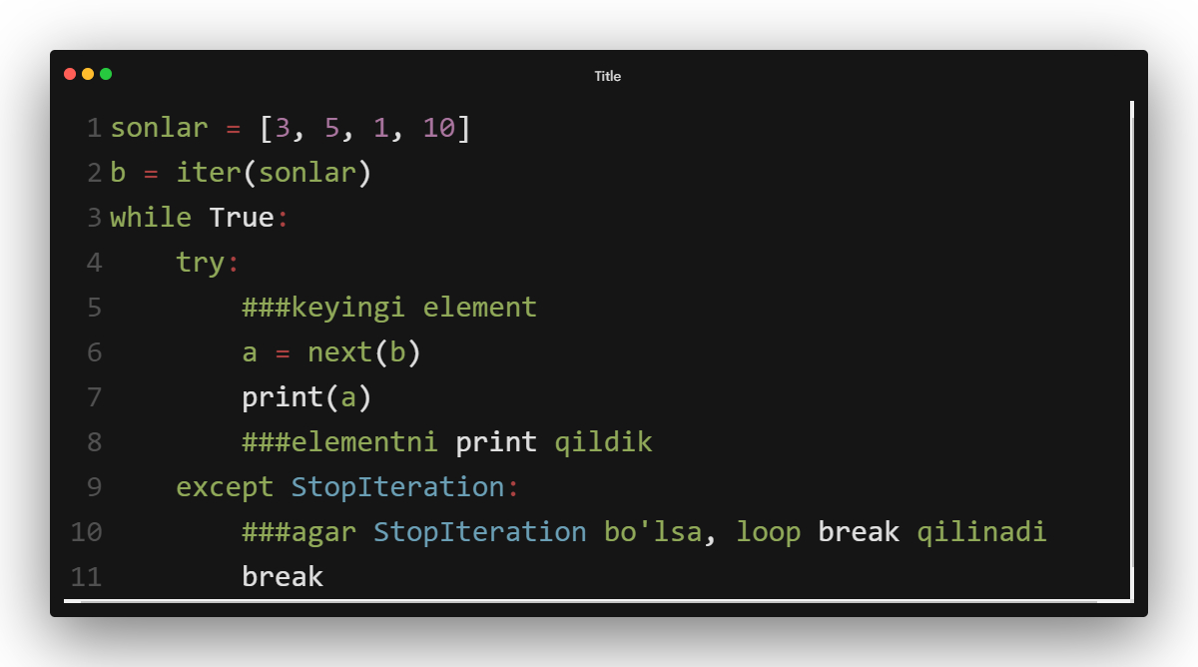
Iterator yaratish

Slide 6
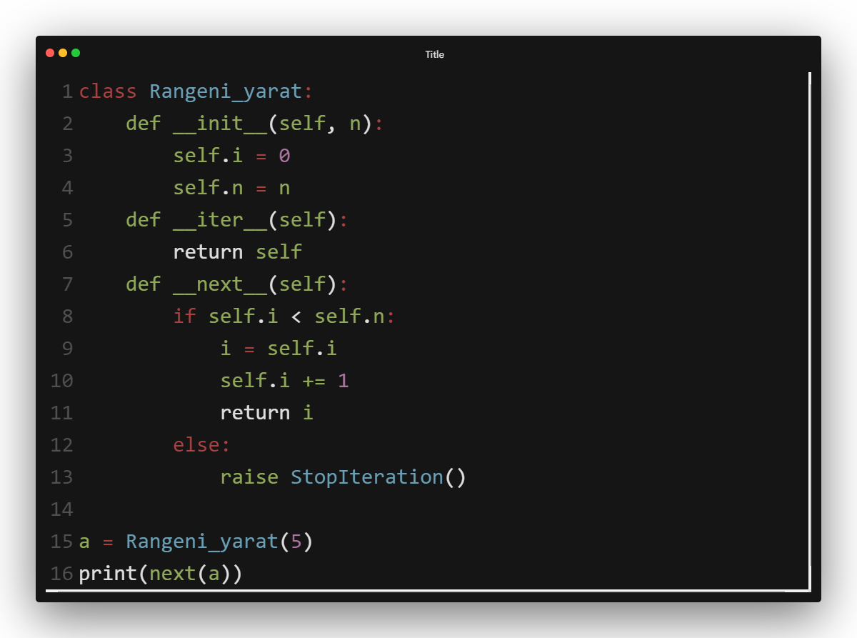

Slide 7
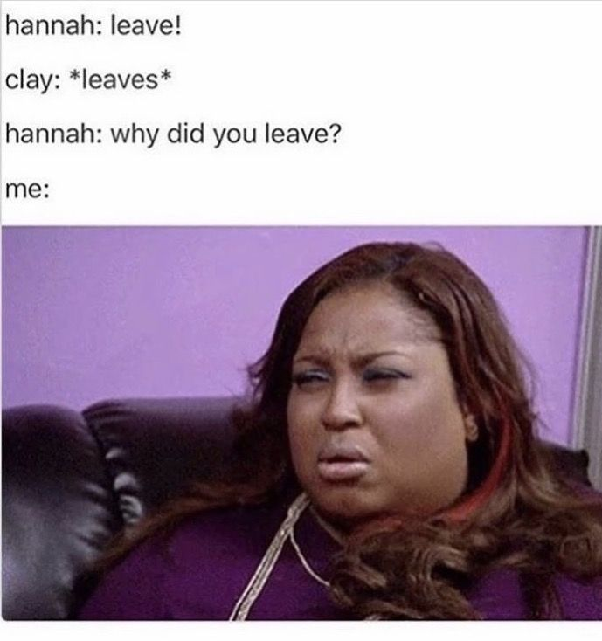
Iterator yaratish
O’zi shundog’am loop lar bor. Nimaga iterator yaratishimiz kerak?

Slide 8
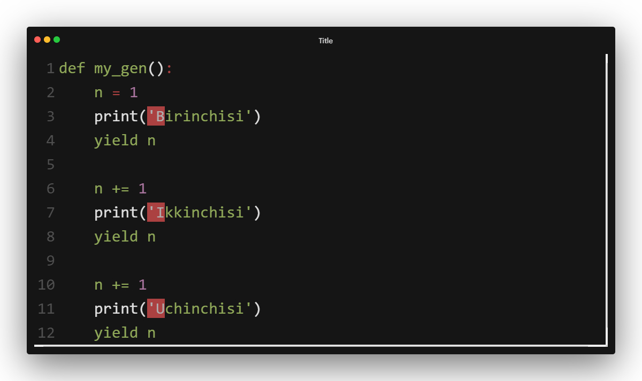
Generatorlar

